Slide 1




Bajaj Finance Dataset Analysis
By : Geetu R . Sanjay
22csu340
DSA-1

Slide 2
INTRODUCTION
Background:
Stock price analysis is crucial for understanding market trends and making informed investment decisions. Financial institutions like Bajaj Finance rely on historical price data and technical indicators to predict future stock movements, optimize trading strategies, and minimize risks.
Problem Statement:
The goal of this project is to develop a machine learning model to predict stock price movements for Bajaj Finance. By leveraging features such as moving averages, stochastic oscillators, and volatility indicators, we aim to analyze how these factors influence price fluctuations and enhance predictive accuracy for future stock trends.

Slide 3
Dataset Overview
DATA OVERVIEW:
•Dimension of the Dataset would be (58646,60)
•Data Types contain Integer, Float, Boolean, Date and Time, Char .
•Purpose: Analyze financial data for classification or regression.
Key Attributes :
Date: Timestamp
Close, High, Low, Open: Stock prices
Volume: Trading volume
SMA (Simple Moving Averages): SMA5, SMA10, SMA15, etc.
FastD, FastK: Stochastic Oscillator
ATR: Average True Range
BETA: Risk measure (Beta coefficient)

Slide 4

Evolution of Models
Types of Model:
Regression: Predict continuous outcomes such as closing price.
Suggested Regression Models:
Linear Regression
Multiple Linear Regression (MLR)
Polynomial Regression
Ridge Regression
Lasso Regression

Slide 5

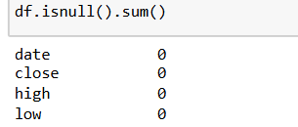
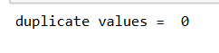
Preprocessing Steps :
Missing Values: No significant missing values were found in the dataset.
Duplicates: The dataset was checked, and duplicates were removed (if any).
Outlier Treatment: Used IQR and Zscore for managing outliers

Slide 6
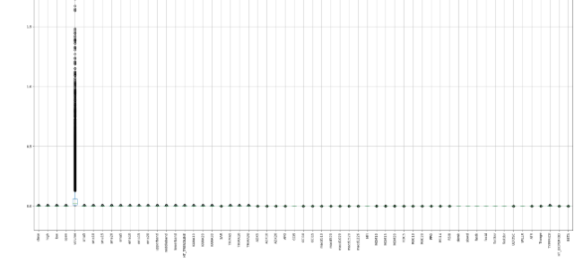
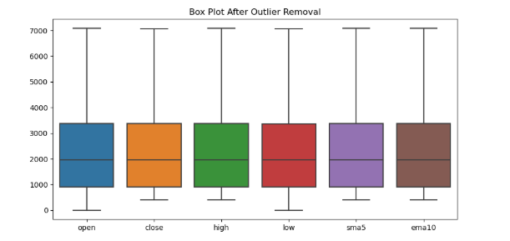
Preprocessing Steps :
Box Plot before Outlier Treatment
Box Plot after Outlier Treatment
Removed Outliers: 24 rows were removed after z-score analysis and IQR ananlysis

Slide 7
ML Regression Models:
Regression helped to predict the closing prices of Bajaj Finance stocks based on historical data (e.g., open price, high price, low price, and technical indicators).
Types of Regression used :
LINEAR REGRESSION: To establish a simple linear relationship between predictors (, open) and the target variable (close price).
Insights:
Demonstrated some predictive power but suffered from higher error due to the linearity assumption.

Slide 8
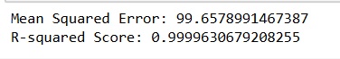
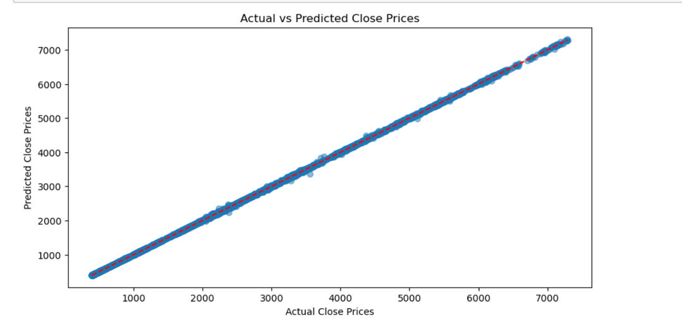
ML Regression Models:
Model Performance:
High R2 Score: 0.99850, indicating the model explains most of the data's variance.
Elevated MSE: 99.657 Likely due to outliers, with one data point significantly deviating from the regression line.

Slide 9
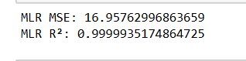
ML Regression Models:
2. MULTIPLE LINEAR REGRESSION: To establish a simple linear relationship between predictors (open, high, low, sma5, ema10) and the target variable (close).
Insights:
Identified a strong linear relationship, but some variance remained unexplained, prompting further exploration.
BUT the decrease in MLR can be seen as per linear

Slide 10
ML Regression Models:
Summary of MLR Assumptions:
Multicollinearity: No issues; VIF values are low.
Linearity: Residuals vs predicted values plot indicates linearity. but with some extreme data points
Homoscedasticity: Residuals appear evenly spread, satisfying this condition.
Normality of Residuals: Approximate normality, but with some outliers.
Autocorrelation: Satisfied based on the Durbin-Watson statistic.

Slide 11
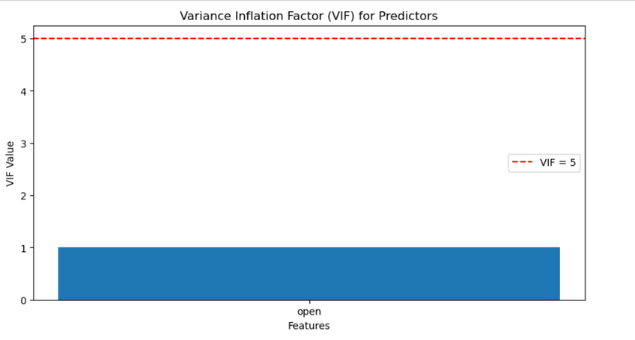
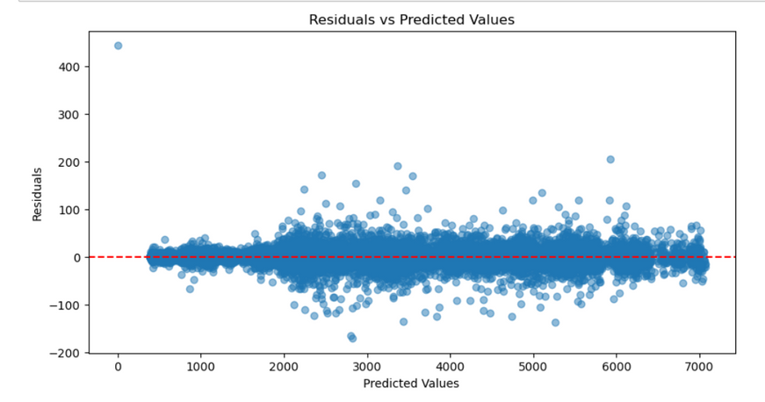
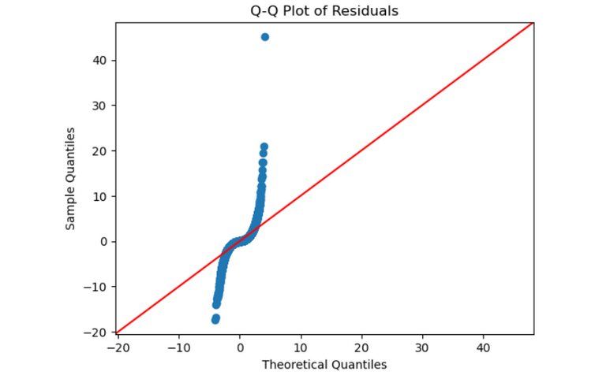
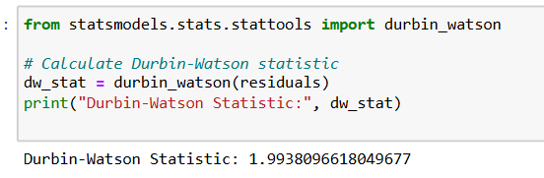
no multicollinearity issues, as the VIF values for the predictors are well below the threshold of 5
The spread of residuals appears fairly constant, indicating the homoscedasticity assumption is reasonably satisfied
The value is close to 2, indicating no significant autocorrelation in the residuals.
A few significant outliers, particularly one extreme point, deviate from the line, which might influence model accuracy.

Slide 12
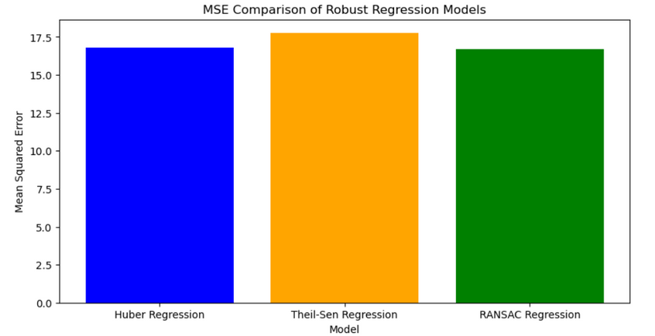
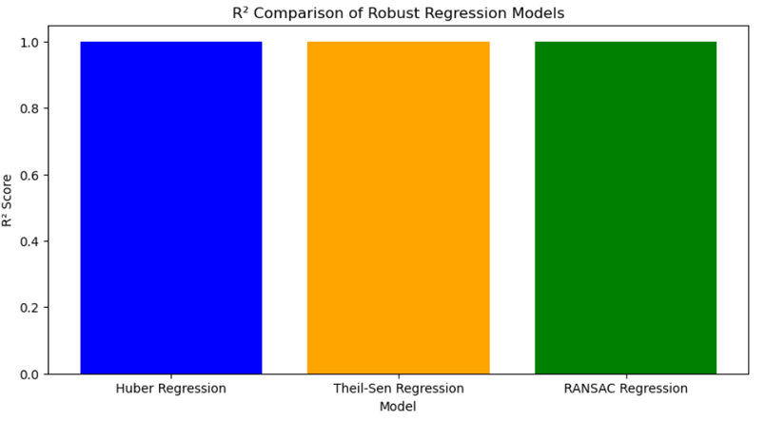
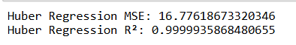
ML Regression Models:
3. ROBUST REGRESSION: To minimize the influence of outliers for more reliable and stable predictions.
Techniques Explored:
Huber Regression:
Combines strengths of MSE (Mean Squared Error) and MAE (Mean Absolute Error).
Suitable for datasets with mild to moderate outliers.
Theil-Sen Regression:
Non-parametric and robust against extreme outliers.
Calculates coefficients by evaluating all pairwise slopes.
RANSAC Regression:
Iteratively fits the model to inliers while ignoring outliers.
Ideal for datasets with a large proportion of outliers.

Slide 13
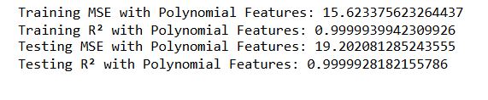
ML Regression Models:
4.Polynomial Features: To capture non-linear relationships between the predictors (open, high, low, sma5, ema10) and the target variable (close).
Polynomial features include:
Interaction terms (e.g., open * high).
Higher-order terms (e.g., open^2).

Slide 14
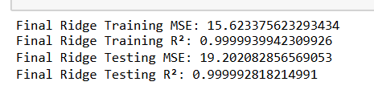
ML Regression Models:
5.RIDGE REGRESSION: To reducethe magnitude of coefficients without setting them to zero. Also, Balances the trade-off between bias and variance.
Key Insight:
Ridge Regression retained low error and high accuracy, making it a better choice than Lasso Regression.

Slide 15
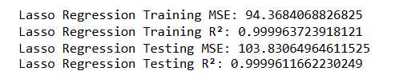
ML Regression Models:
6.LASSO REGRESSION: To Performs feature selection by shrinking some coefficients to zero.
Key Insight:
Lasso showed higher error and slightly reduced R2R^2R2 due to excessive regularization (α=100\alpha = 100α=100), resulting in underfitting.

Slide 16
CONCLUSION
Explored multiple regression techniques to optimize prediction accuracy and minimize error.
Model Comparison:
Linear Regression: Initial approach but showed higher error due to sensitivity to outliers.
Polynomial Regression:Captured non-linear relationships and reduced error, but overfitting risks persisted.
Robust Regression (Huber, Theil-Sen, RANSAC):Addressed outliers effectively, with RANSAC providing the best performance among robust techniques.
Ridge and Lasso Regression:Ridge outperformed Lasso, achieving low error and maintaining generalization.
Final Model Selection:
Ridge Regression with α=0.001\alpha = 0.001α=0.001 was chosen:
Training MSE: 15.623
Testing MSE: 19.202
R2: 0.99999 (for both training and testing)

Slide 17
Thank you very much!

